Slide 1
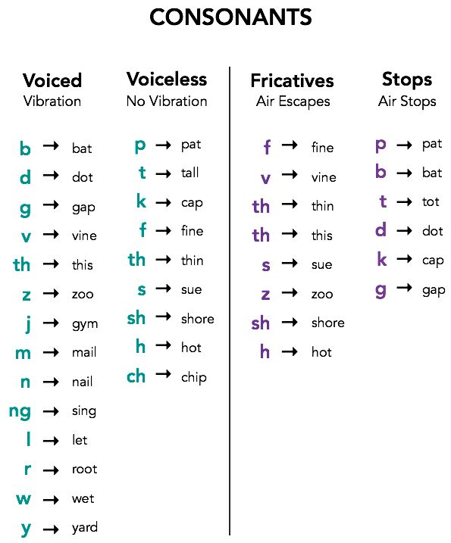
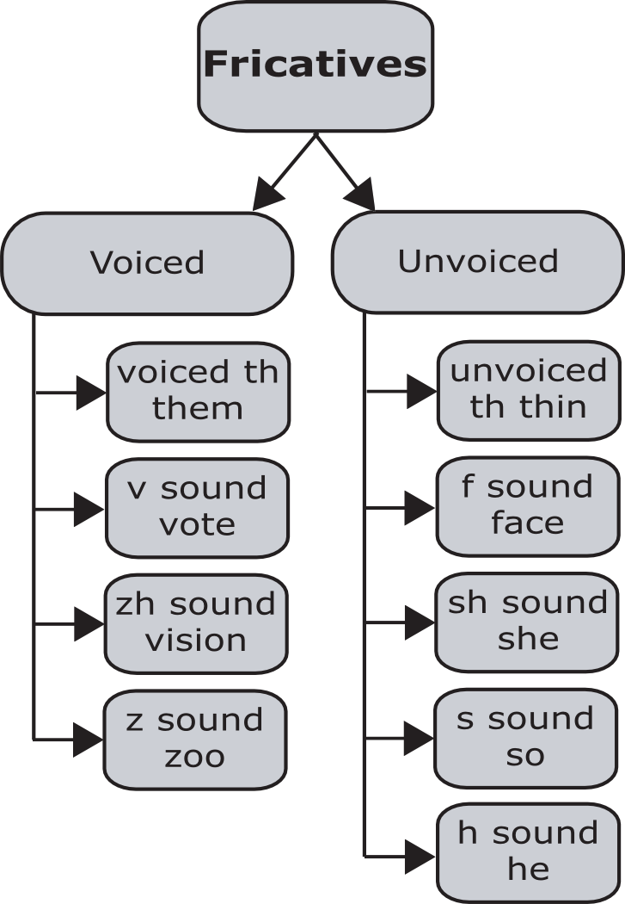
Voiced and voiceless sounds chart
Fricatives

Slide 2
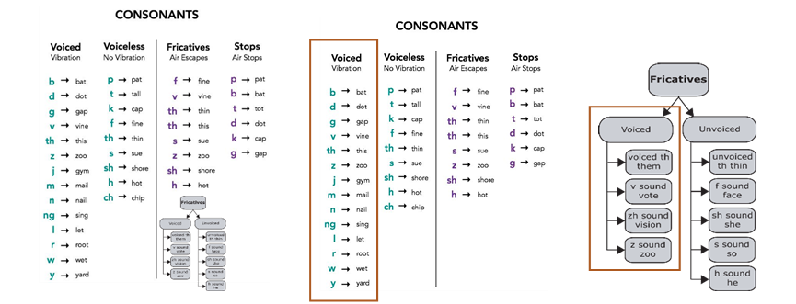
Voice with formant
Voice without formant

Slide 3
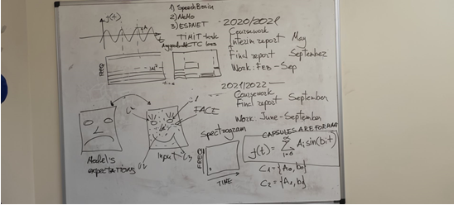

Slide 4
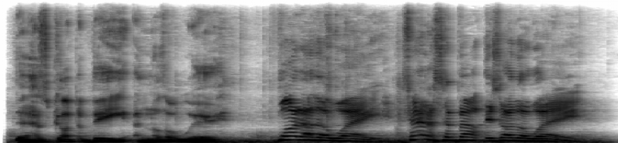
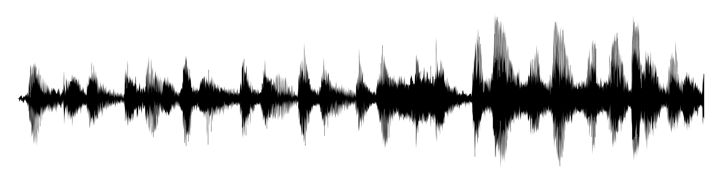
Grapheme/Word
_characteristic_
character istic
Phoneme
Linguistic Features
K EH2 R AH0 K T ER0 IH1 S T IH0 K
Mel-Spectrogram
Spectrogram
Waveform

Slide 5
The waveform img is from https://pixabay.com/images/search/waveform/
The spectrogram is generated by https://spectrogram.birdiememory.com/
The wav file of the spectrogram is from https://www.wavsource.com/tv/game_of_thrones/game_of_thrones_s3e10.htm
(The first one ‘Another way’)

Slide 6
Waveform
Pre-Processing
Feature Extraction
Spectrogram/..
Filter Bank Output/..
MFCC/LPCC/...
Classification model
Language model
Text

Slide 7
Waveform
Mel-Spectrogram
Formant Capsule Info:
Freq, bw,..
Transformer Capsule Layer (encoder)
Formant Capsule Info
phoneme Capsule Info:
Formant-capsule_1(start,end)
Formant-capsule_2(start,end)
Formant-capsule_3(start,end)
…
Transformer Capsule Layer (encoder)
phoneme Capsule Info
Formant Speech Synthesizer
Transformer
(decoder)
Text

